Slide 1
Amazon Top 50 Bestselling Books
2009-2019
Presented by: Kaisaris Dimitris
Last updated: October 27th, 2021

Slide 2
Table of contents
Genre Comparison
Fiction vs NonFiction
Top 50 and Top 10 Charts
Tableau Dashboard
Which is the most popular genre
Appendix

Slide 3
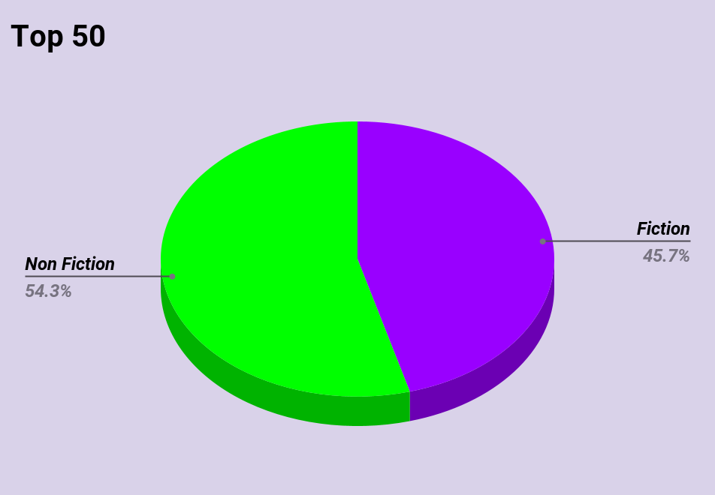
Top 50
2009-2019
54.3% of the books reaching top 50 are
Non Fiction
45.7% of the books reaching top 50 are
Fiction

Slide 4
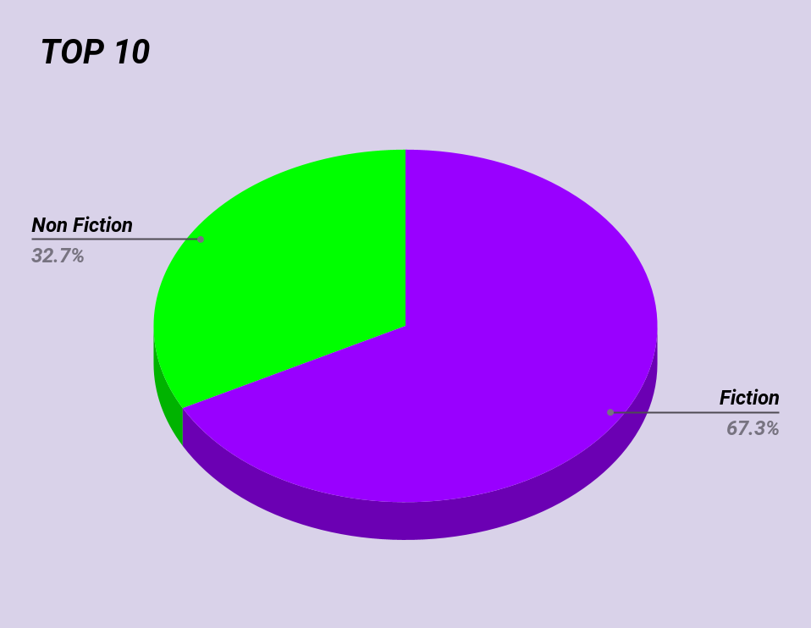
Top 10
2009-2019
Reaching top 10, Fiction Books now take 67.3% of the whole, while NonFiction 32.7%
Notes:
Reaching top 10 , fiction books take a massive lead

Slide 5
Trend towards Fiction?
At top 50 , the population of Fiction and NonFiction books are almost equal with a slide edge towards NonFiction.But reaching top 10, Fiction books are more than double!!

Slide 6
Next an image from Tableau dashboard,
showing top 10 and top 1 over the years,
including infos for rating, titles and author!
Visit: https://public.tableau.com/app/profile/dimitris.kaisaris4695
for interactive use!

Slide 7
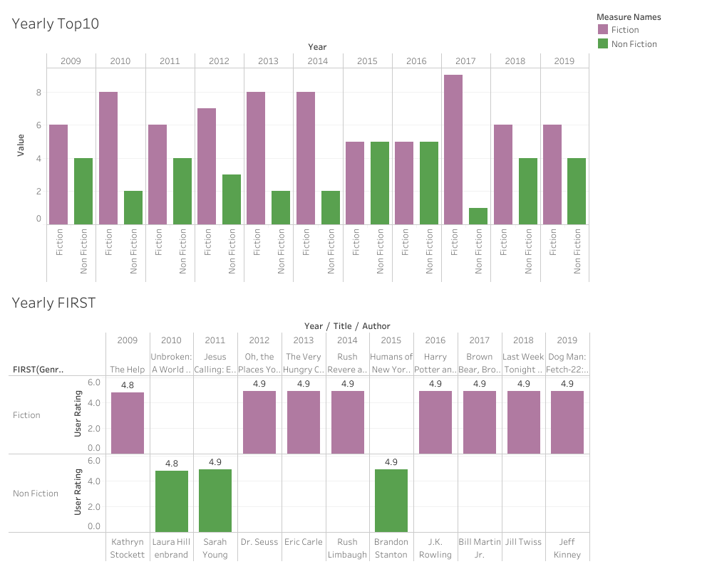

Slide 8
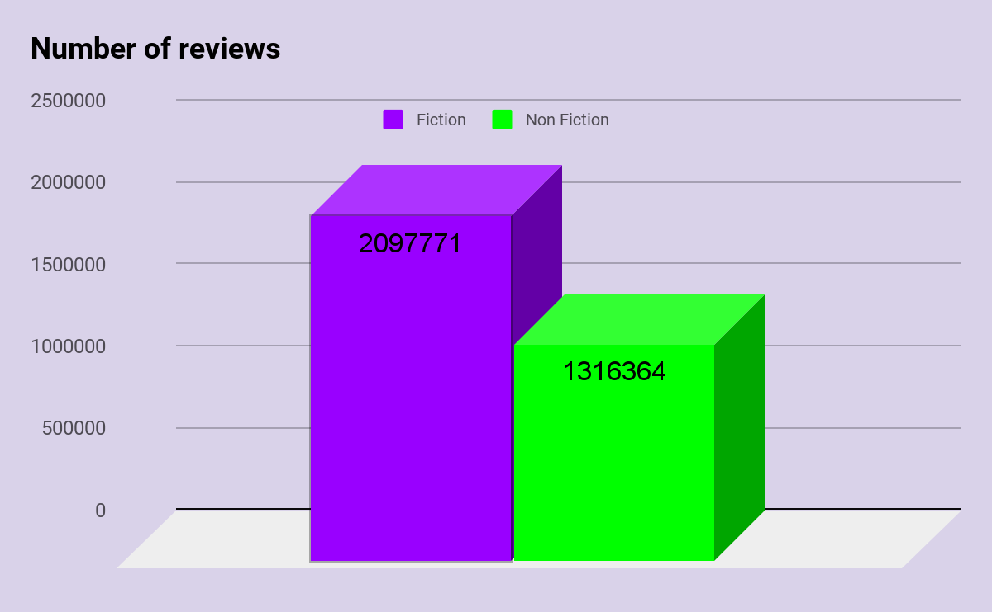
Final Data and Conclusion

Slide 9
Final Data and Conclusion
Checking also the number of total reviews, fiction books even if they are outnumbered,
they have a massive lead.

Slide 10
Final Data and Conclusion
Checking also the number of total reviews, fiction books even if they are outnumbered,
they have a massive lead.
Conclusion: FICTION BOOKS are more popular!

Slide 11
THANK YOU
The dataset is taken from: https://www.kaggle.com/
and it is for practice purposes only!

